Slide 1
Linux Assembly
Armine Hayrapetyan

Slide 2
Outline
“Hello, World” Source Code
Registers
System Calls

Slide 3
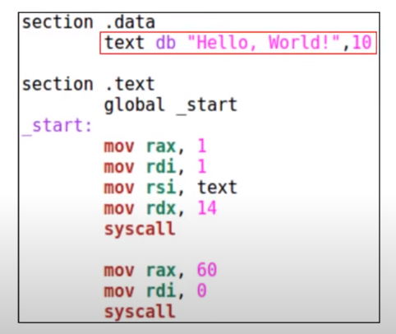
“Hello, World” Source Code

Slide 4
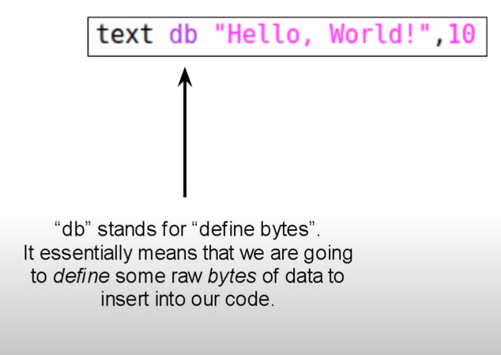
db

Slide 5
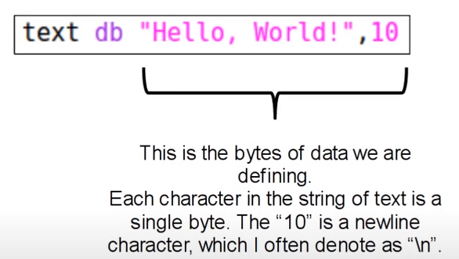
db

Slide 6
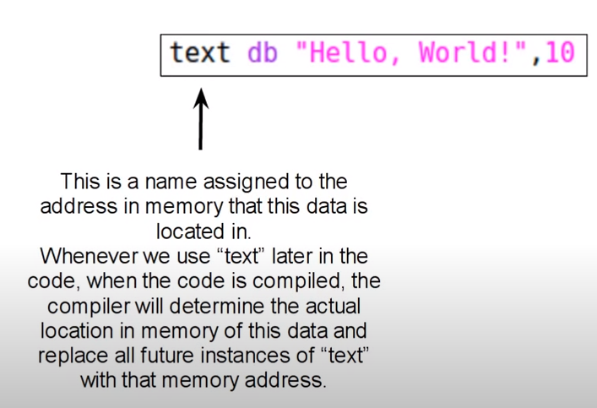
db

Slide 7
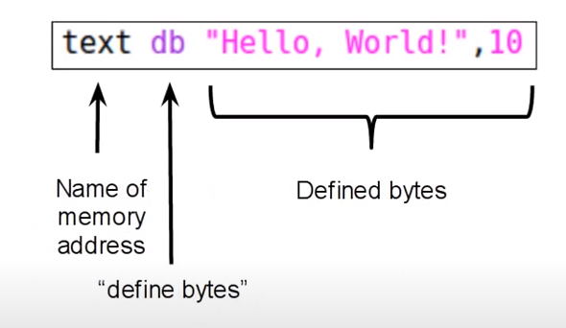
db

Slide 8
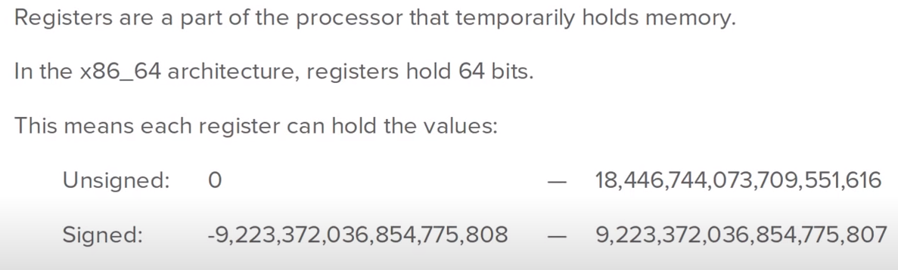
Registers

Slide 9
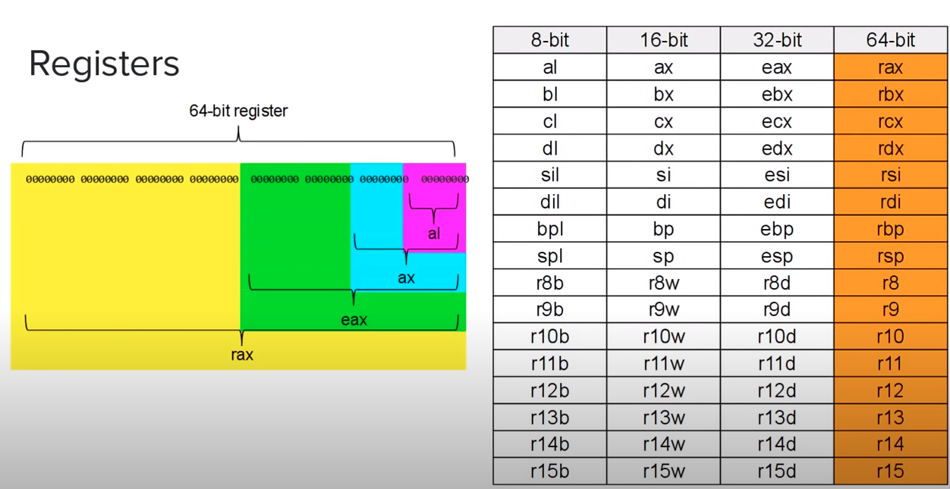

Slide 10
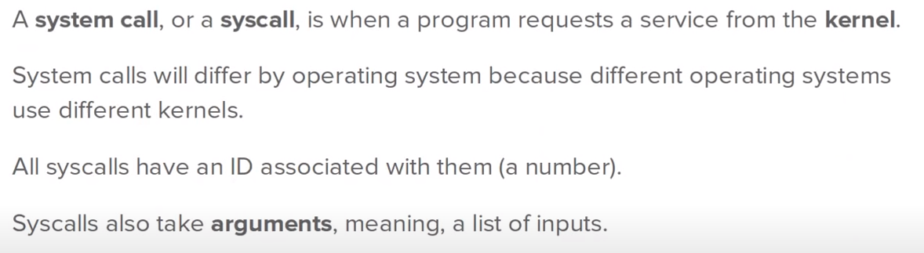
System Call

Slide 11
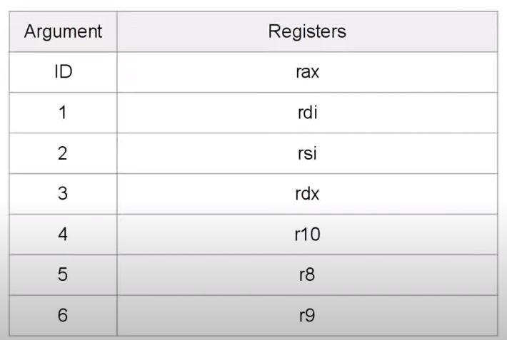
System Call Inputs by Register

Slide 12
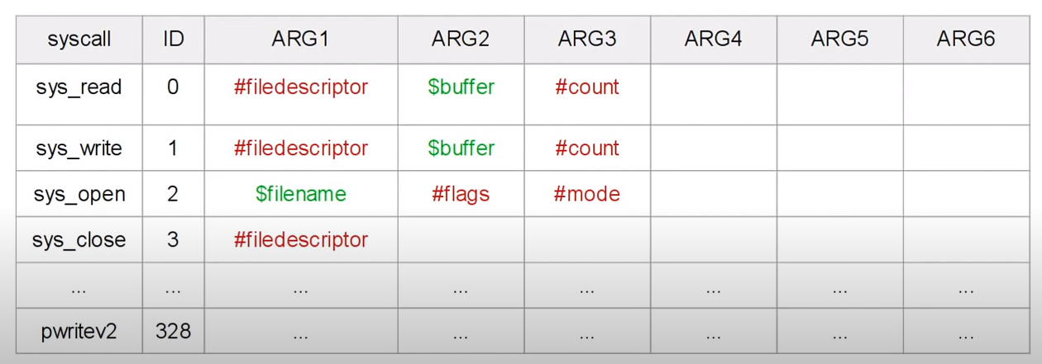
System Call List

Slide 13
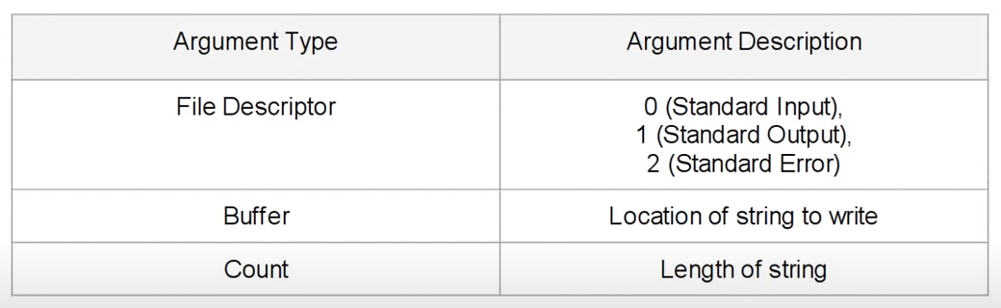
sys_write

Slide 14
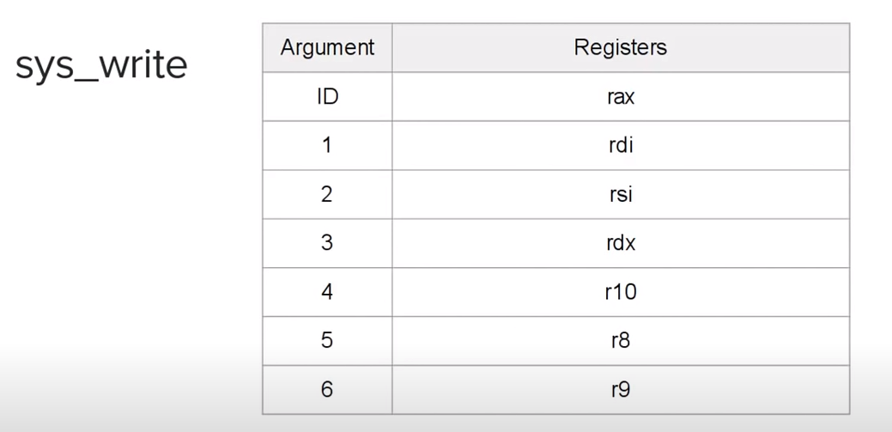

Slide 15
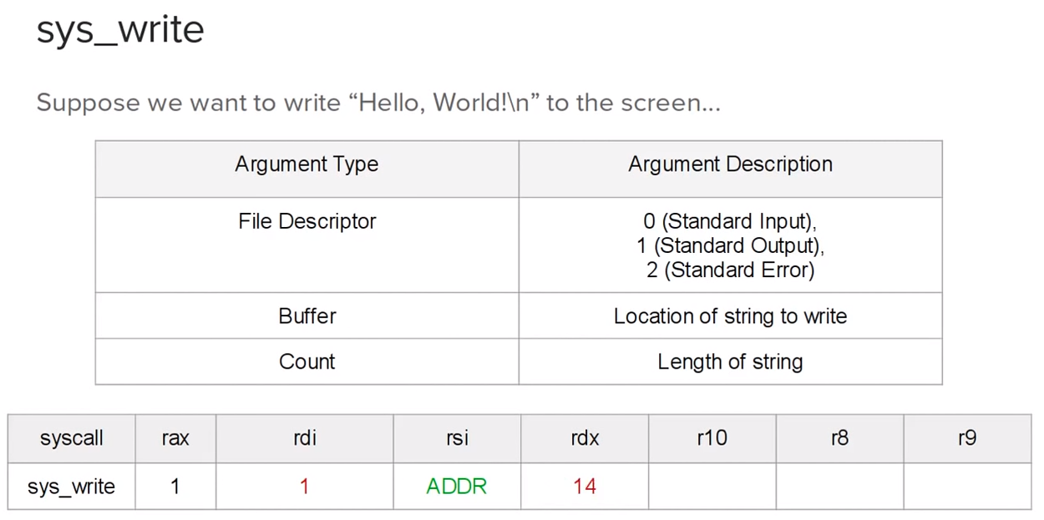

Slide 16
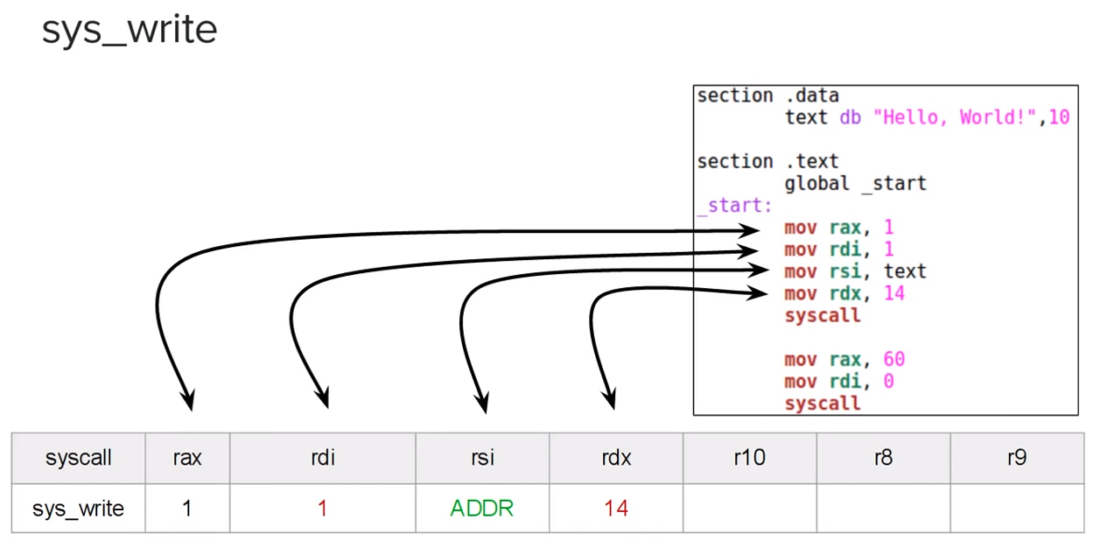

Slide 17
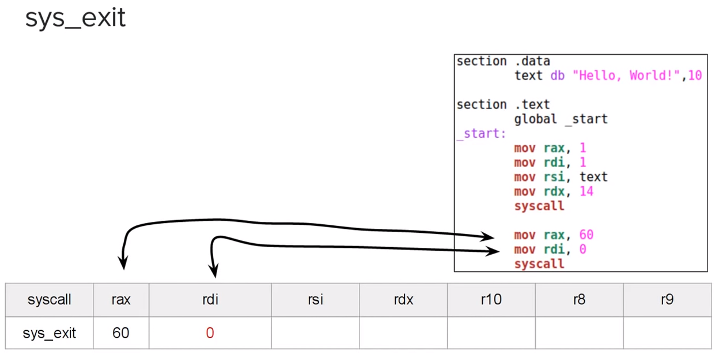

Slide 18
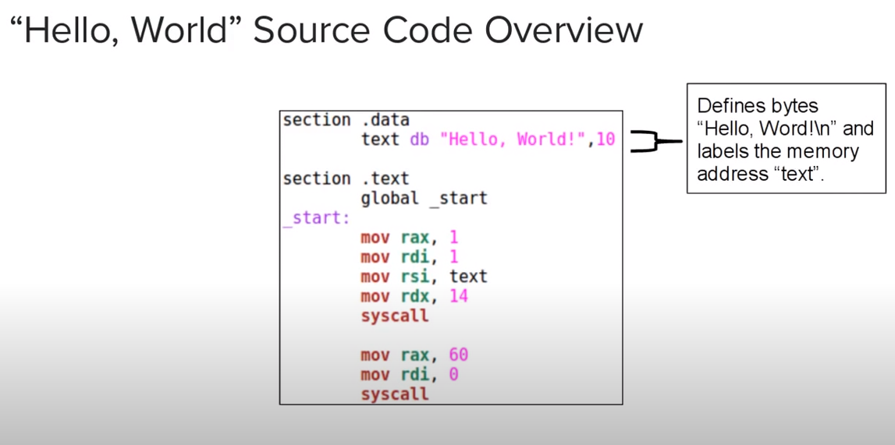

Slide 19
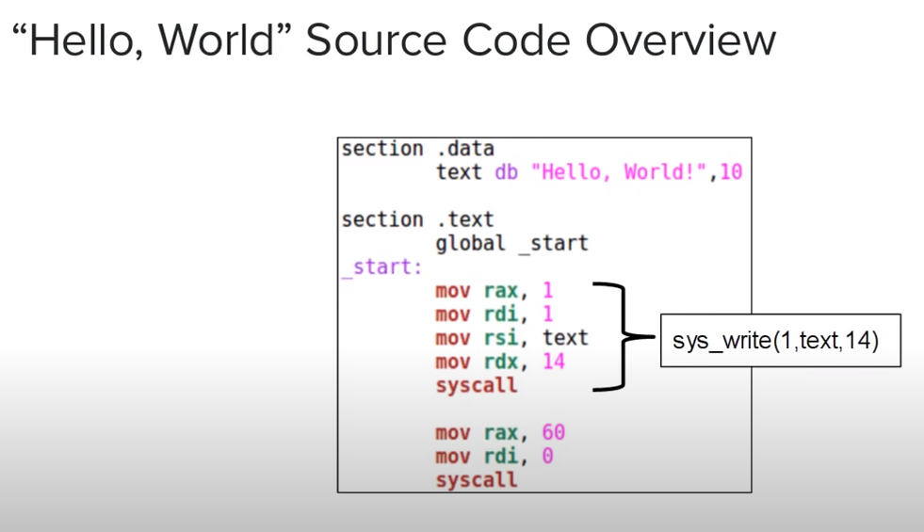

Slide 20
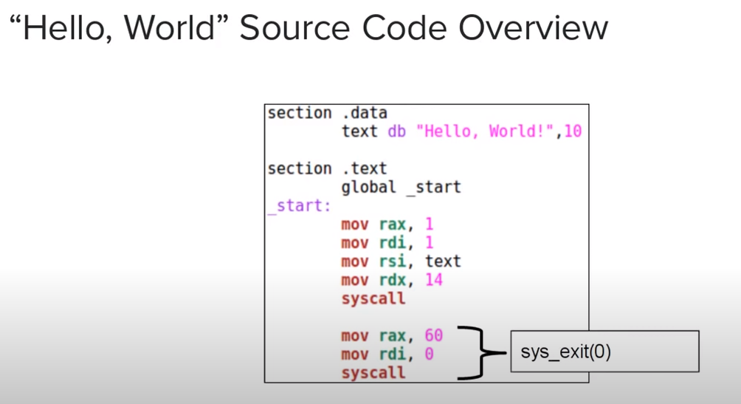

Slide 21
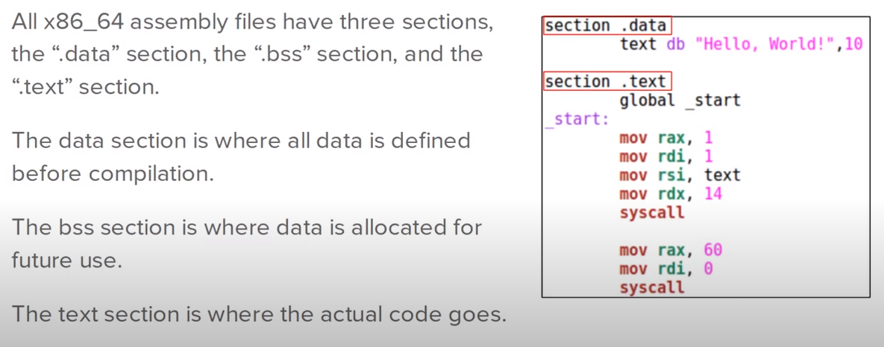
Sections

Slide 22
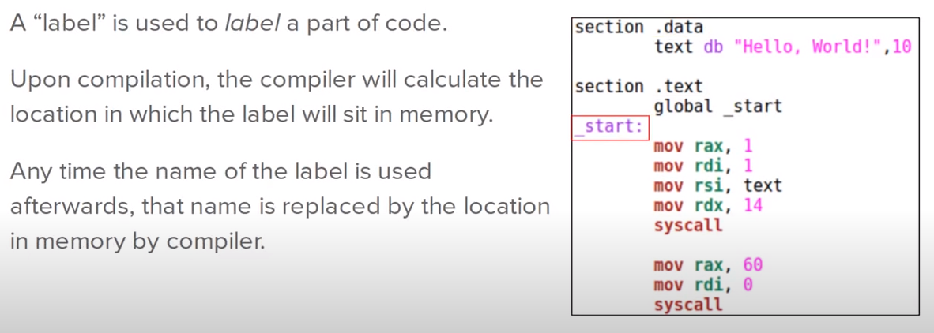
Label

Slide 23
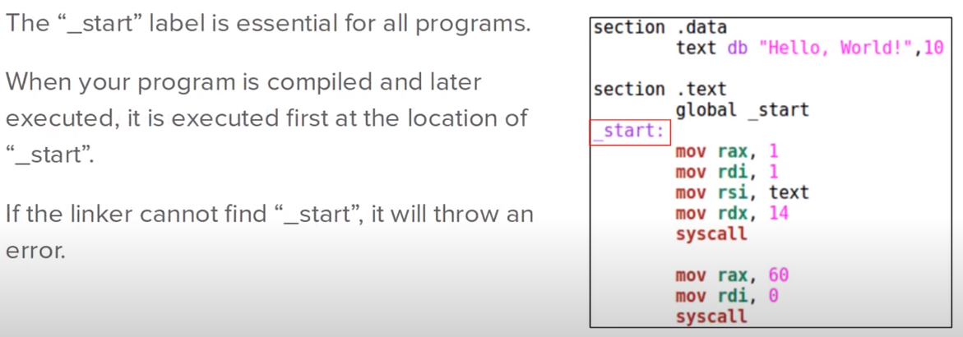
The “Start” Label

Slide 24
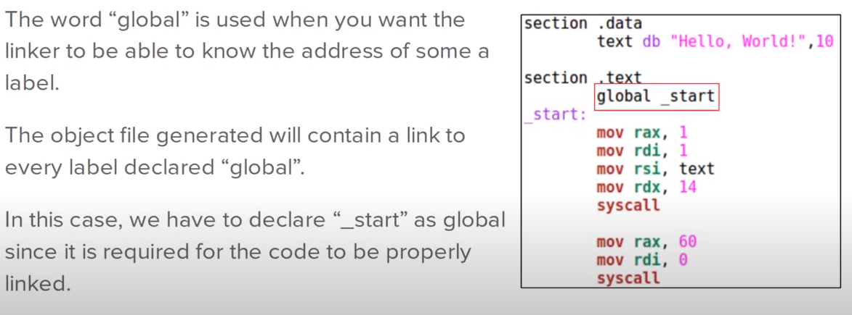
Global

Slide 25
References
https://www.youtube.com/watch?v=BWRR3Hecjao&list=PLetF-YjXm-sCH6FrTz4AQhfH6INDQvQSn&index=2
https://www.youtube.com/watch?v=VQAKkuLL31g&list=PLetF-YjXm-sCH6FrTz4AQhfH6INDQvQSn&index=1

